Slide 1

CYBER A2
Date: 15-04-2026
Student’s Name
Manal Fatima
25F-CY-062
Taha Khan
25F-CY-088
Noor Fatima
25F-CY-108
Subject Teacher
Sir Faisal
1

Slide 2
POLITICAL &
CONSTITUTIONAL
HISTORY OF PAKISTAN
From Independence to the Modern Democratic Era
1947 — 2025
Seven Eras • Seven Constitutions • One Nation's Journey
2

Slide 3
Pakistan's Seven Political Eras — At a Glance
1947–1958
Founding & Instability
1958–1971
Ayub Khan's Military Rule
1971–1977
Bhutto's Democratic Era
1977–1988
Zia ul-Haq's Islamization
1988–1999
Democratic Decade
1999–2008
Musharraf's Technocracy
2008–2025
Return to Democracy
3

Slide 4
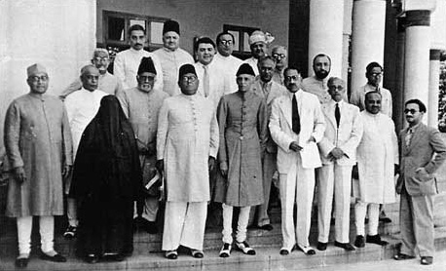
Lahore Resolution & Basic Principles Committee
1940–1952
Lahore Resolution — March 23, 1940
Basic Principles Committee — 1947–1952
• Passed at the All-India Muslim League session in Lahore on March 23, 1940
• Demanded independent states for Muslim-majority areas of northwestern and eastern India
• Moved by A.K. Fazlul Haq (Premier of Bengal); presided over by Quaid-e-Azam Jinnah
• Did not explicitly use 'Pakistan' — but became foundational document of Pakistan Movement
• Declared that no constitutional plan would be acceptable unless Muslim-majority areas were grouped into independent states
• Constituent units to be autonomous and sovereign; minorities' rights guaranteed
• Later called 'Pakistan Resolution' — celebrated annually as Pakistan Day (March 23)
• Rejected the concept of a united India under a single federal constitution
• Galvanized Muslim political identity; gave the demand for Pakistan formal constitutional expression
• Constituent Assembly of Pakistan formed a Basic Principles Committee (BPC) in March 1949
• Tasked with drafting the basic principles of the future constitution of Pakistan
• Chaired by Liaquat Ali Khan; sub-committees on franchise, federal structure, and fundamental rights
• First BPC Report (1950): proposed unicameral legislature; equal representation for provinces — sparked East Pakistan controversy
• East Pakistan rejected report — Bengali leaders demanded proportional representation based on population
• Second BPC Report (1952): proposed bicameral legislature — House of Units and House of People
• Recommended strong centre; federal structure with limited provincial autonomy
• Controversy over parity vs. population representation between East and West Pakistan remained unresolved
• BPC reports laid groundwork for the Constitution of 1956 — though process took 9 years due to political deadlock
4
Political & Constitutional History of Pakistan | Pre-Independence & Early Constitution-Making
Era I | 1940–1952

Slide 5
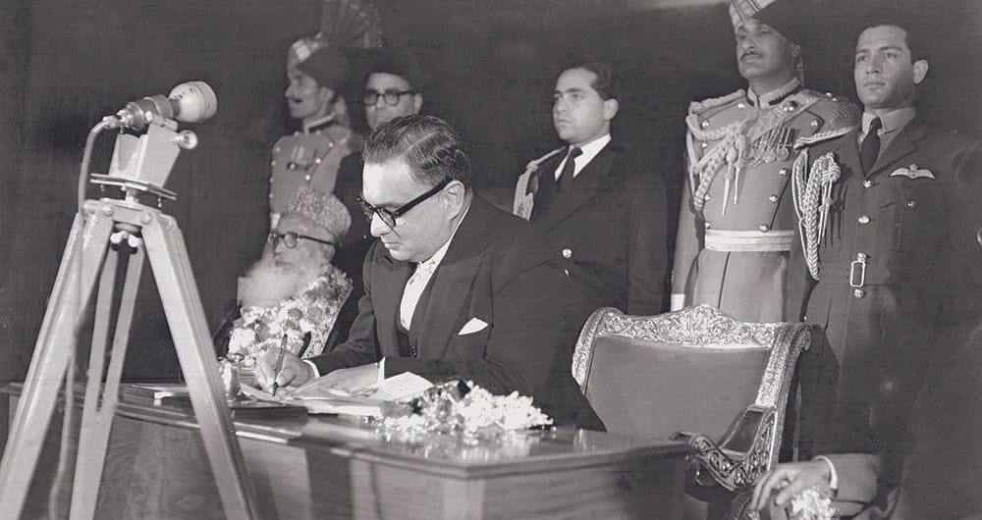
1947 – 1958
I
ERA
Independence, Constitution-Making & Early Political Instability
5

Slide 6
Birth of a Nation — Independence & Early Governance
1947–1958
Independence & Partition
Constitutional Challenges
Pakistan achieved independence on August 14, 1947 under the leadership of Muhammad Ali Jinnah (Quaid-e-Azam)
Created from British India under the Indian Independence Act 1947, comprising West Pakistan and East Pakistan (separated by 1,600 km of Indian territory)
Jinnah became first Governor-General; Liaquat Ali Khan became first Prime Minister
Government of India Act 1935 adopted as interim constitution pending a new one
Partition led to one of history's largest mass migrations — 14 million displaced, widespread violence
Capital established at Karachi; no treasury, army, or civil service of its own
The Constituent Assembly (elected 1946) tasked with drafting a constitution
Objectives Resolution passed March 1949 — declared Pakistan an Islamic state; foundational for all future constitutions
Jinnah died September 1948 — enormous leadership vacuum created
Liaquat Ali Khan assassinated October 1951 — political chaos deepened
Successive PMs: Nazimuddin, Bogra, Chaudhry Mohammad Ali — rapid turnover
Governor-General Ghulam Mohammad dismissed PM Nazimuddin in 1953 — setting precedent for executive overreach
6

Slide 7
Constitution of 1956 & Political Breakdown
1947–1958
Constitution of 1956
Political Instability & Coup
First constitution of Pakistan enacted on March 23, 1956 — Pakistan declared an Islamic Republic
Parliamentary system with bicameral legislature; President as constitutional head
Islam declared state religion; fundamental rights guaranteed
One Unit scheme (1955) merged all West Pakistan provinces into one unit to balance East Pakistan
Iskander Mirza became first President under the new constitution
Federal structure with division of powers between center and provinces
Between 1947–1958, Pakistan had 7 Prime Ministers — democratic institutions never stabilized
Political parties, especially Muslim League, plagued by factionalism
Landlord-dominated politics resisted land reforms and mass participation
Economic difficulties, refugee crises, and lack of administrative machinery
President Iskander Mirza abrogated the 1956 Constitution on October 7, 1958
General Ayub Khan declared Martial Law; within 20 days ousted Mirza himself — First Military Coup
7

Slide 8
Key Figures — 1947–1958
Era I
QAM
LAK
GMA
MIM
Muhammad Ali Jinnah
Liaquat Ali Khan
Ghulam Mohammad
Iskander Mirza
Founder / Gov-General
Prime Minister
Governor-General
President
1947–1948
1947–1951
1951–1955
1956–1958
Quaid-e-Azam, founder of Pakistan. Led Muslim League's demand for a separate homeland. Died in office Sept 1948.
First PM of Pakistan. Passed Objectives Resolution 1949. Assassinated Oct 1951 in Rawalpindi.
Controversial G-G who dismissed elected PMs and undermined parliamentary democracy.
First President under 1956 Constitution. Abrogated it himself in Oct 1958; was then exiled by Ayub Khan.
8

Slide 9
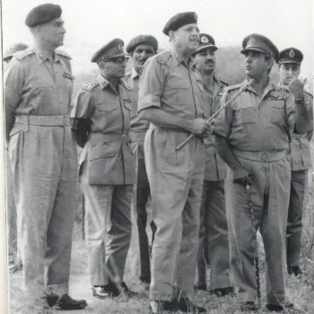
1958 – 1971
II
ERA
Ayub Khan's Martial Law, Basic Democracies & the 1962 Constitution
9

Slide 10
Ayub Khan's Military Government & 1962 Constitution
1958–1971
Military Takeover & Governance
Constitution of 1962
Gen. Ayub Khan seized power October 27, 1958 — suspended constitution, dissolved assemblies
Imposed Martial Law Regulations; political parties banned until 1962
Introduced Basic Democracies Order 1959 — 80,000 elected 'Basic Democrats' at local level served as electoral college
1960 Referendum: Ayub given presidential mandate by Basic Democrats
Land reforms (1959) attempted to reduce feudal landholdings — partially implemented
Rapid industrialization and economic growth in 1960s earned label 'Decade of Development'
New constitution promulgated June 8, 1962 — Presidential system replacing parliamentary democracy
Single strong executive president; indirect elections through Basic Democrats
National Assembly of 156 members; Provincial Assemblies created
Fundamental rights curtailed compared to 1956 constitution
Pakistan named 'Republic of Pakistan' (Islamic removed from title initially)
One Unit scheme maintained; Dhaka declared second capital and seat of National Assembly
10

Slide 11
Decline of Ayub Khan & the Road to East Pakistan Crisis
1958–1971
Political Opposition & Agos
Yahya Khan & 1970 Elections
1965 Indo-Pak War ended in stalemate; Tashkent Declaration (January 1966) deeply unpopular
Zulfikar Ali Bhutto left cabinet; founded Pakistan People's Party (PPP) in 1967
Mujibur Rahman's Awami League demanded autonomy under Six-Point Programme (1966)
Mass agitation movement in West Pakistan 1968–69 led by students and labor
Fatima Jinnah opposed Ayub in 1965 presidential election — lost in contested result
Ayub resigned March 25, 1969 — handed power to Army Chief Gen. Yahya Khan
Gen. Yahya Khan declared Martial Law; abrogated 1962 constitution
Legal Framework Order (LFO) 1970 set rules for first general elections based on one-person-one-vote
General elections held December 1970 — Awami League won absolute majority nationally
Awami League: 160/162 seats in East Pakistan; PPP: 81/138 in West Pakistan
Transfer of power refused by Yahya and Bhutto — triggering East Pakistan crisis
Operation Searchlight launched March 25, 1971 — military crackdown in East Pakistan
11

Slide 12
Key Figures — 1958–1971
Era II
AYK
ZAB
MUR
YAK
Gen. Ayub Khan
Z.A. Bhutto
Sheikh Mujibur Rahman
Gen. Yahya Khan
President / CMLA
FM / PPP Founder
Awami League Chief
President / CMLA
1958–1969
1963–1971
1966–1971
1969–1971
Pakistan's first military ruler. Modernized economy but suppressed democracy. Resigned amid mass protests.
Foreign Minister under Ayub. Founded PPP 1967. Rose to power after 1971 breakup of Pakistan.
Led East Pakistan's demand for autonomy. Won 1970 elections decisively. Became Bangladesh's founding father.
Held 1970 elections but refused to transfer power. Oversaw East Pakistan military operation; resigned after 1971 war.
12

Slide 13
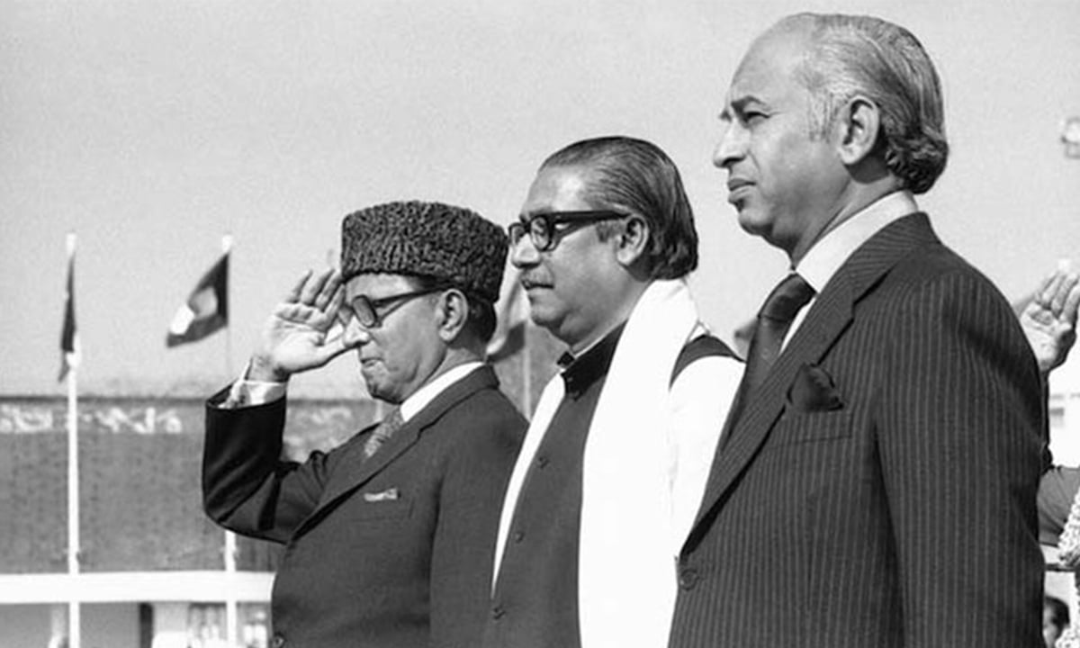
1971 – 1977
III
ERA
Bhutto's Era — Constitution of 1973 & Civilian Democracy
13

Slide 14
1971 War, Dismemberment & Bhutto's Rise
1971–1977
1971 War & Bangladesh
Bhutto's Democratic Socialism
Indian military intervened December 3, 1971; Pakistani forces in East Pakistan surrendered December 16, 1971
93,000 Pakistani soldiers became POWs — largest military surrender since World War II
East Pakistan became independent Bangladesh — Pakistan lost more than half its population
Gen. Yahya Khan resigned; Zulfikar Ali Bhutto became President and Chief Martial Law Administrator
Simla Agreement (July 1972) signed with India — normalized relations; POWs returned
National trauma redefined Pakistan's identity; military's prestige shattered
Bhutto introduced sweeping nationalization: banks, industries, schools
Land reforms (1972) — ceiling on individual landholdings reduced
Labor reforms, free education policy, expanded social services
Introduced concept of 'Islamic Socialism'
Relations with major powers reoriented; 1974 Islamic Summit hosted in Lahore
Covert nuclear weapons program initiated after India's 1974 nuclear test
14

Slide 15
Constitution of 1973 — Pakistan's Enduring Charter
1971–1977
Key Features of 1973 Constitution
Bhutto's Decline & Fall
Passed by consensus of all major parties — April 12, 1973; came into effect August 14, 1973
Parliamentary democracy restored — PM as chief executive; President as constitutional head
Bicameral parliament: National Assembly (lower) + Senate (upper, representing provinces)
Islam as state religion; Quran and Sunnah as supreme law
Fundamental rights with strong provisions on equality, expression, assembly
Federal structure with Concurrent Legislative List for center-province shared powers
Still in force today — though amended 25+ times
1977 general elections — PPP won landslide; opposition Pakistan National Alliance (PNA) alleged massive rigging
Street protests paralyzed the country for months
Bhutto agreed to negotiate with PNA but military stepped in
General Zia ul-Haq ousted Bhutto on July 5, 1977 — Third Martial Law
Bhutto arrested and tried for alleged murder of a political opponent
Executed April 4, 1979 — most controversial judicial execution in Pakistani history
PPP and Bhutto's legacy dominated Pakistani politics for decades after
15

Slide 16
Key Figures — 1971–1977
Era III
ZAB
NRB
FBZ
MFC
Z.A. Bhutto
Nurul Amin
Begum Nusrat Bhutto
Fazlur Rehman
President / PM
PM (briefly)
Opposition Leader
Constitutional Negotiator
1971–1977
Dec 1971
1977–1988
1973
Most charismatic Pakistani leader. Gave Pakistan its 1973 constitution. Overthrown by Zia; executed 1979.
Last PM under Yahya's martial law. In office only a few weeks during the 1971 war's final days.
Led PPP after ZAB's imprisonment and execution. Kept party alive through Zia's repression.
Religious scholars and multiple parties negotiated the 1973 constitution — a rare moment of consensus.
16

Slide 17
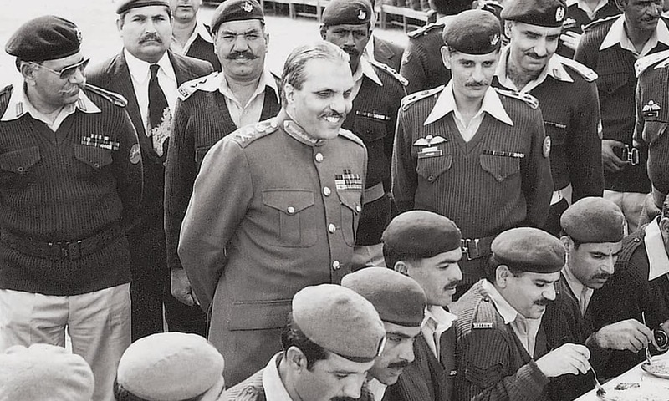
1977 – 1988
IV
ERA
Gen. Zia ul-Haq — Islamization, Afghan War & Constitutional Amendments
17

Slide 18
Zia's Martial Law & Islamization Program
1977–1988
Military Rule & Political Suppression
Islamization Policies
General Muhammad Zia ul-Haq declared Martial Law July 5, 1977 — suspended constitution
Promised elections in 90 days — elections postponed repeatedly for 11 years
Political parties banned, press censored; public floggings and amputation as punishments introduced
Bhutto's trial and execution (1979) deeply polarized the nation
Movement for Restoration of Democracy (MRD) launched 1981 — Sind became center of resistance
Non-party elections held 1985 under Zia's new constitutional framework
Hudood Ordinances (1979): punishment for adultery, theft, alcohol under Sharia
Blasphemy laws significantly strengthened (Section 295-C added 1986)
Zakat and Ushr Ordinance (1980): compulsory Islamic wealth tax
Federal Shariat Court established to review laws against Quran and Sunnah
Separate electorates for non-Muslims — minorities marginalized in politics
Islamization of education curriculum — textbooks rewritten with religious emphasis
18

Slide 19
Afghan Jihad, 8th Amendment & Zia's Legacy
1977–1988
Afghan War & Geopolitics
8th Amendment & Constitutional Legacy
Soviet invasion of Afghanistan (Dec 1979) transformed Pakistan into a frontline state
Pakistan became conduit for US/Saudi arms to Afghan Mujahideen via ISI
3 million Afghan refugees arrived in Pakistan — largest refugee population at the time
Pakistan received massive military and economic aid from USA ($3.2 billion in 1980s)
Kalashnikov culture and narcotics trade entered Pakistan as side effects
Nuclear weapons program accelerated under A.Q. Khan — Pakistan tested cold devices
Revival of Constitution Order 1985 — 1973 constitution restored with major amendments
8th Amendment (1985): President given power to dismiss PM and dissolve assemblies (Article 58-2b)
Created 'Troika' system: President, PM, and Army Chief sharing power informally
Gen. Zia died in air crash August 17, 1988 along with US Ambassador and senior military officers
Cause of crash remains disputed — sabotage never conclusively proven
Zia's Islamization irreversibly changed Pakistani society, law, and politics
19

Slide 20
Key Figures — 1977–1988
Era IV
ZUH
GIB
MAJ
BRB
Gen. Zia ul-Haq
Ghulam Ishaq Khan
Muhammad Khan Junejo
Benazir Bhutto
CMLA / President
Senate Chairman
Prime Minister
PPP Leader / Exiled
1977–1988
1985–1988
1985–1988
1984–1988
Longest-ruling military dictator. Islamized Pakistan's legal system. Died in mysterious air crash 1988.
Powerful bureaucrat-turned-politician. Became President after Zia's death; used 8th Amendment to dismiss PMs.
Civilian PM under Zia. Dismissed by Zia for signing Geneva Accords on Afghanistan independently.
Returned from exile 1986 to massive crowds. Led PPP to election victory after Zia's death in 1988.
20

Slide 21
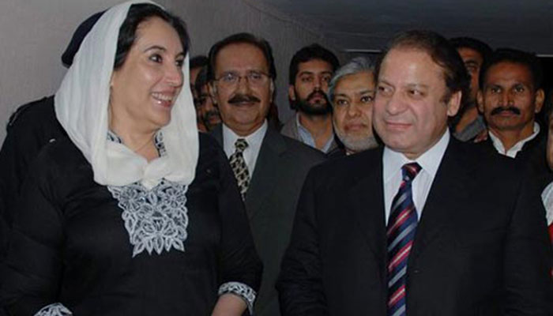
1988 – 1999
V
ERA
Democratic Decade — Benazir & Nawaz, the 8th Amendment Carousel
21

Slide 22
The Democratic Decade — Alternating Governments
1988–1999
Benazir's First Term (1988–1990)
Nawaz Sharif's First Term (1990–1993)
PPP won November 1988 elections — Benazir Bhutto became PM, first female PM in Muslim world
Government weak — dependent on MQM alliance; military and President constrained her
President Ghulam Ishaq Khan dismissed her government Aug 1990 under 8th Amendment
Charges of corruption and incompetence; fresh elections called
Nawaz Sharif (IJI) won Oct 1990 elections with large majority
Economic liberalization, privatization, infrastructure development
Conflict with President GIK and Army Chief Gen. Asif Nawaz
Both PM Nawaz and President GIK dismissed each other in 1993 constitutional crisis
Army brokered both resignations; caretaker government installed
Supreme Court initially restored Nawaz but he ultimately resigned under pressure
22

Slide 23
Political Instability & Kargil Crisis
1988–1999
Benazir's 2nd Term & Nawaz's 2nd Term
Kargil War & Military Coup
Benazir Bhutto won 1993 elections — second term as PM
Farooq Leghari (PPP nominee) became President but dismissed BB's govt in 1996
Charges: corruption, extra-judicial killings (Karachi operation), husband Asif Zardari
Nawaz Sharif won Feb 1997 elections with massive 2/3 majority
13th Amendment (1997): abolished President's power to dismiss PM under 58-2b
Nawaz declared Pakistan a nuclear power after India's 1998 Pokhran tests — massive popular support
Kargil War (May–July 1999): Pakistani soldiers/militants occupied Indian positions in Kashmir
Nawaz claimed he was not informed of operation — civil-military tensions peaked
US intervention forced withdrawal; Nawaz blamed Army; Gen. Musharraf blamed civilian interference
Nawaz attempted to dismiss Gen. Musharraf while he was airborne returning from Sri Lanka
Army stopped plane at Karachi airport; October 12, 1999 — Gen. Musharraf declared emergency
Fourth military coup — Nawaz arrested, tried, exiled to Saudi Arabia
23

Slide 24
Key Figures — 1988–1999
Era V
BBZ
NAS
GIK
FLG
Benazir Bhutto
Nawaz Sharif
Ghulam Ishaq Khan
Farooq Leghari
Prime Minister
Prime Minister
President
President
1988–90, 93–96
1990–93, 97–99
1988–1993
1993–1997
Twice elected PM. Navigated constant civilian-military tension. Assassinated 2007 on return from exile.
Led Pakistan's nuclear tests 1998. Dismissed twice. Exiled by Musharraf 1999; returned 2007.
Used 8th Amendment to dismiss two elected PMs. Eventually resigned amid constitutional standoff.
PPP nominee who dismissed his own party's PM Benazir Bhutto in 1996 on corruption charges.
24

Slide 25
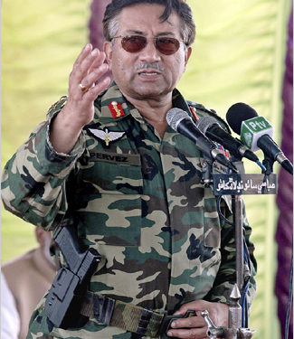
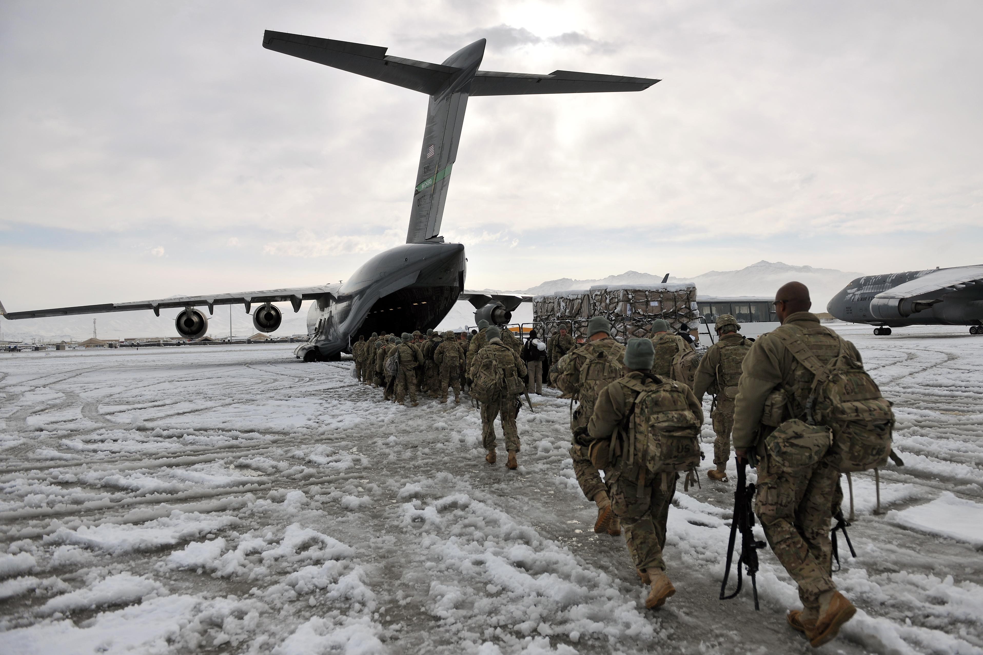
1999 – 2008
VI
ERA
Gen. Musharraf — Enlightened Moderation, War on Terror & 17th Amendment
25

Slide 26
Musharraf's Military Government & Reforms
1999–2008
Seizure of Power & Early Reforms
Post-9/11 Alignment & War on Terror
Gen. Pervez Musharraf declared himself Chief Executive Oct 12, 1999; later President
Provisional Constitutional Order (PCO) 1999 suspended constitution
National Accountability Bureau (NAB) established — anti-corruption accountability courts
Devolution Plan: Local Government Ordinance 2001 created elected district government system
Media revolution — private TV channels and FM radio licensed for first time
Economy: macroeconomic stabilization, debt rescheduling after 9/11 dividend
Pakistan joined US-led War on Terror after September 11, 2001 — US sanctions lifted
Billions in aid; army deployed to FATA to fight Al-Qaeda and Taliban affiliates
Operation in South Waziristan, North Waziristan; hundreds of Al-Qaeda leaders captured
Terrorism blowback: major attacks in Pakistani cities; suicide bombings became routine
Musharraf survived multiple assassination attempts
Afghan Taliban leadership sheltered in Quetta (Quetta Shura) — double game allegations
26

Slide 27
17th Amendment, Judicial Crisis & Return of Democracy
1999–2008
17th Amendment & Constitutional Changes
Judicial Crisis & Fall of Musharraf
Legal Framework Order (LFO) 2002: constitutional amendments via decree
17th Constitutional Amendment (Dec 2003): legitimized Musharraf's changes; NSC institutionalized
Article 58-2b restored — President could again dismiss PM
2002 elections under new political engineering — MMA (religious alliance) won large bloc
PM Zafarullah Khan Jamali, then Shaukat Aziz as PM; power really with Musharraf
March 2007: Musharraf suspended Chief Justice Iftikhar Chaudhry — lawyers' movement erupted
Lawyers' Long March — nationwide civil society movement demanding judicial independence
Emergency declared November 3, 2007 — judges sacked, new PCO imposed
Benazir Bhutto returned from exile Oct 2007; assassinated December 27, 2007 in Rawalpindi
February 2008 elections: PPP won; Asif Ali Zardari became President
Musharraf resigned August 18, 2008 under impeachment threat — went into exile
27

Slide 28
Key Figures — 1999–2008
Era VI
PMU
ZAJ
SAZ
ICH
Gen. Pervez Musharraf
Zafarullah Jamali
Shaukat Aziz
CJ Iftikhar Chaudhry
COAS / President
Prime Minister
Prime Minister
Chief Justice
1999–2008
2002–2004
2004–2007
2005–2013
Pakistan's last military ruler. 'Enlightened moderation' doctrine. Resigned 2008; convicted in absentia 2019.
First PM from Balochistan. Resigned under pressure; replaced by more Musharraf-friendly Shaukat Aziz.
Ex-Citibank banker. Managed economic growth period. Faced growing terrorism and political challenges.
Focal figure of lawyers' movement. Reinstated 2009; led activist Supreme Court era.
28

Slide 29
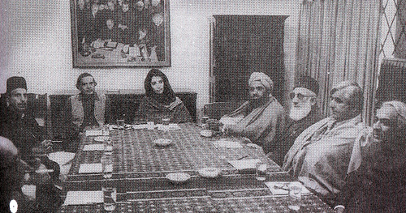
2008 – 2025
VII
ERA
Restoration of Democracy, 18th Amendment, PTI Revolution & Hybrid Regime
29

Slide 30
PPP Government & 18th Amendment (2008–2013)
2008–2025
PPP's Democratic Governance
18th Amendment — Constitutional Watershed
PPP won Feb 2008 elections; Yousuf Raza Gilani became PM; Asif Zardari became President
First civilian government to complete full 5-year term since independence (2008–2013)
Judges' Restoration: Chief Justice Iftikhar Chaudhry restored March 2009 after Long March pressure
Supreme Court became assertive — contempt cases, suo motu actions, PM dismissal
PM Gilani disqualified by Supreme Court 2012 for contempt; PM Raja Pervaiz Ashraf continued
Massive terrorism, energy crisis, floods of 2010 (affecting 20 million) challenged governance
18th Constitutional Amendment (April 2010): most comprehensive amendment in Pakistan's history
Presidential power to dissolve assembly (58-2b) abolished — restored parliamentary supremacy
Concurrent Legislative List abolished — major devolution of power to provinces
Renamed NWFP to Khyber Pakhtunkhwa (KPK)
Strengthened Senate and provincial governments
PM's term limits removed, federalism significantly strengthened
30

Slide 31
Nawaz Sharif's Third Term & PTI Rise (2013–2018)
2008–2025
Nawaz's Third Term & Panama Papers
PTI's Rise & 2018 Elections
PML-N won May 2013 elections — first democratic transfer of power between two civilian governments
PM Nawaz Sharif focused on infrastructure: CPEC, motorways, Lahore Orange Line Metro
CPEC (China-Pakistan Economic Corridor): $62 billion investments announced
Panama Papers leaks (2016) revealed offshore accounts of Nawaz family
Supreme Court disqualified Nawaz Sharif in July 2017 (Panamagate verdict)
Shahid Khaqan Abbasi completed remainder of term as PM
Imran Khan's PTI had emerged as third force through 2011 Lahore jalsa
2018 elections contested — PTI won with military backing allegations from opposition
Imran Khan became PM August 2018; promised 'Naya Pakistan' — anti-corruption, welfare state
Economic crisis, IMF bailout, rupee devaluation marked PTI's tenure
FATF grey-listing; crackdown on militant financing; relations with US deteriorated
Opposition united under PDM (Pakistan Democratic Movement) in 2020
31

Slide 32
Imran Khan's Ouster, Hybrid Regime & 2024 Elections
2008–2025
Vote of No-Confidence & Political Crisis
2024 Elections & Current Period (2024–2025)
April 2022: Imran Khan removed through vote of no-confidence — first PM to be so removed
Shehbaz Sharif (PML-N) became PM; coalition PDM government
Imran Khan launched massive protest movement; May 9, 2023 — military installations attacked after his arrest
PTI leaders arrested en masse; party declared terrorist organization by some provincial govts
Imran Khan arrested Aug 2023; multiple cases including cipher case, iddat case filed
Economic crisis deepened — inflation over 38%, rupee at record lows; IMF program renegotiated
General elections February 8, 2024 — PTI (as independents) won most seats but denied majority
PML-N and PPP formed coalition government; Shehbaz Sharif returned as PM
Asif Ali Zardari elected President for second time
26th Constitutional Amendment (Oct 2024): judiciary restructured; constitutional benches established — highly controversial
PTI continued protests; Imran Khan remained imprisoned; political polarization at historic high
Economy stabilized somewhat with IMF Extended Fund Facility; inflation easing but challenges remain (2025)
32

Slide 33
Key Figures — 2008–2025
Era VII
AAZ
NAS
IKH
SSS
Asif Ali Zardari
Nawaz Sharif
Imran Khan
Shehbaz Sharif
President / PPP Co-Chair
Prime Minister
Prime Minister / PTI
Prime Minister
2008–2013, 2024–
2013–2017
2018–2022
2022–23, 2024–
Became President after Benazir's assassination. Oversaw 18th Amendment. Elected President again in 2024.
Third PM tenure ended by Supreme Court's Panamagate verdict. Returned from exile 2023; son Maryam now leads PML-N.
Cricket legend turned PM. Ousted by no-confidence vote 2022. Imprisoned 2023; became center of mass political movement.
Current PM heading PML-N led coalition. Focused on economic stabilization and IMF program continuity.
33

Slide 34
Pakistan's Constitutional Milestones — Comparative Overview
Constitution / Order | Year | System | Key Features | Ended By
Govt. of India Act 1935 (adapted) | 1947 | Governor-General/PM | Interim constitution; British framework retained | New Constitution 1956
Constitution of 1956 | 1956 | Parliamentary | Islamic Republic; PM supreme; provincial autonomy | Ayub's coup 1958
Constitution of 1962 | 1962 | Presidential | Basic Democracies; indirect elections; strong presidency | Yahya's Martial Law 1969
Constitution of 1973 | 1973 | Parliamentary | Senate created; Islam as state religion; still in force | Zia's Martial Law 1977 (suspended)
PCO 1981 | 1981 | Martial Law | Zia's constitutional orders; 8th Amendment 1985 | 1985 Revival of Constitution
8th Amendment era | 1985 | Semi-Presidential | President could dismiss PM; Troika system | 13th Amendment 1997
PCO 1999 | 1999 | Military/CE | Musharraf's constitutional order; LFO 2002 | 18th Amendment era 2008
18th Amendment (1973 restored) | 2010 | Parliamentary (devolved) | Provinces empowered; presidential power curtailed | Ongoing (26th Amendment 2024)
34

Slide 35
Recurring Themes in Pakistan's Political History
Civil-Military Imbalance
Constitutional Fragility
Islam & the State
Military intervened 4 times; even civilian govts operated under military influence — the 'hybrid' model.
3 constitutions in 25 years; the 1973 constitution survived through 26 amendments by 2025.
From Objectives Resolution (1949) to Zia's Islamization — religion's role in state fiercely contested.
Democratic Struggle
Geopolitical Pressures
Judiciary's Evolving Role
No PM completed a full term until 2013. First peaceful transfer between civilian govts occurred in 2013.
Cold War, Afghan Jihad, War on Terror, CPEC — external factors repeatedly shaped domestic politics.
From rubber stamp to activist — lawyers' movement and 18th Amendment transformed judicial independence.
35
"Democracy is the best revenge." — Benazir Bhutto | Pakistan — A Nation Resilient in Pursuit of Constitutional Governance

